Slide 1
Software Testing Manual / Selenium Automation
Introduction
SDLC
STLC
Types of Testing
Why automation?
Java –Selenium Introduction
Locators

Slide 2
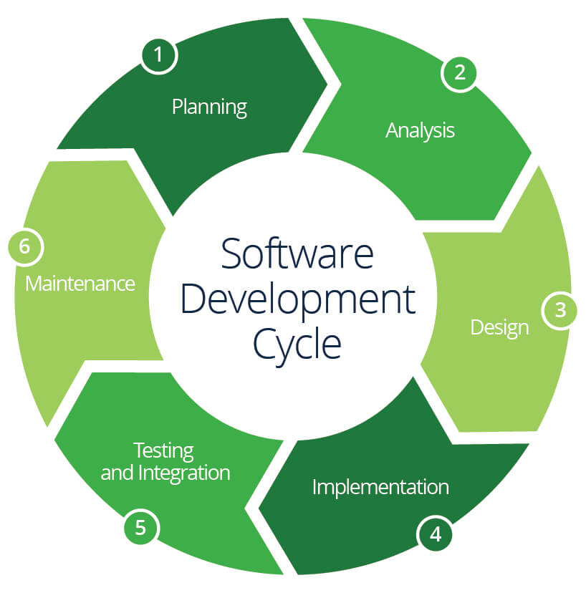
SDLC

Slide 3
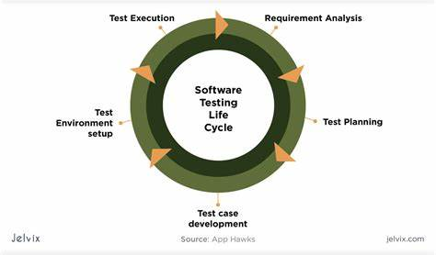
STLC

Slide 4
Software Development Methodologies
1 . Waterfall Model
2. V Model
3. Agile Methodology

Slide 5
Manual Testing
Black box Testing
This testing is also known as Behavioral Testing. The software tests the internal structural, design, and implementation and UI and UX of the product being tested, which is unknown to the tester. Black box testing is both functional or non-functional, but most of the time, it is usually functional.
Functional Testing: Testing funtionality of appications or s/w.
Non Func Testing: checking all the aspects it includes performance, usability, scalability, realiablilty of the software.
It includes response time and speed of the software under the specific conditions.

Slide 6
Types of software Testing
White box Testing
Done by developer
Internal structure , coding, design
Tested to verify flow of input output & improve Design Usability and Security
SMOKE TEST
Smoke test critical component and functionality checks.
Smoke Testing is a software testing process to identify whether the given software build is STABLE or not.

Slide 7
SANITY TESTING
What is Sanity Testing? 👉 Sanity testing is a Software Testing performed after receiving a software build, with minor changes in code, or new functionality, or after a bug fix.
the main aim of this testing to assure that the new functionality is working fine no further issues are introduced due to these changes.
The main difference between Smoke and Sanity is, Smoke will test the critical components across the build whereas Sanity will test the rationality of the particular module which went through a change or a bug fix.

Slide 8
REGRESSION TESTING
Testing module A to Module Z (end to end checks)
No new issues should be introduced across the entire system
Integration Testing is defined as a type of testing where software modules are integrated logically and tested as a group. A typical software project consists of multiple software modules, coded by different programmers.
1.Incremental Approach: which is further divided into the following
Top Down Approach
Bottom Up Approach
Sandwich Approach – Combination of Top Down and Bottom Up
2. Big Bang Approach :

Slide 9
Test Scenario
Test Scenario provides a small description of what needs to be performed based on the use case.
Test Scenarios are derived from documents like BRS,SRS, user story etc
Test scenarios are high-level actions.
Test Case
A Test Case is a set of actions executed to verify a particular feature or functionality of your software application. A Test Case contains test steps, test data, precondition, postcondition developed for specific test scenario to verify any requirement.

Slide 10
For Example
Test Scenario: Check Login Functionality there many possible test cases are:
Test Case 1: Check results on entering valid User Id & Password
Test Case 2: Check results on entering Invalid User ID & Password
Test Case 3: Check response when a User ID is Empty & Login Button is pressed, and many more
Test Case ID | Test Case Description | Test Steps | Test Data | Expected Results | Actual Results | Pass/Fail

Slide 11
Manual Testing Disadvantages:
Repetitive task boring
Time consuming
Complex to perform
Automation Testing is a software testing technique that performs using special automated testing software tools /scripts to execute a test case suite.
Fast
Reliable
Reusable
Productivity
Early Bug Deduction

Slide 12
Java and OOPS
Basic terminologies in Java
1. Class: The class is a blueprint (plan) of the instance of a class (object). It can be defined as a a logical template that share common properties and methods.
2. Object: The object is an instance of a class. It is an entity that has behavior and state.
Example: BMW, maruthi, Volvoc are the object of “CAR” class.
Behavior: Running on the road.
Method: action of the class. Driving , break, gear change

Slide 13
Access Modifier: Defines the access type of the method i.e. from where it can be accessed in your application. In Java, there are 4 types of access specifiers:
public: Accessible in all classes in your application.
protected: Accessible within the package in which it is defined and in its subclass(es) (including subclasses declared outside the package).
private: Accessible only within the class in which it is defined.
default (declared/defined without using any modifier): Accessible within the same class and package within which its class is defined.
Access Specifiers:
1. public - Global Level Access
(inside package (extends, object)) + outside package (extends, object)
2. protected - (inside package (extends, object)) + outside package (extends)
3. default - (inside package (extends, object))
4. private - Only within the Class

Slide 14
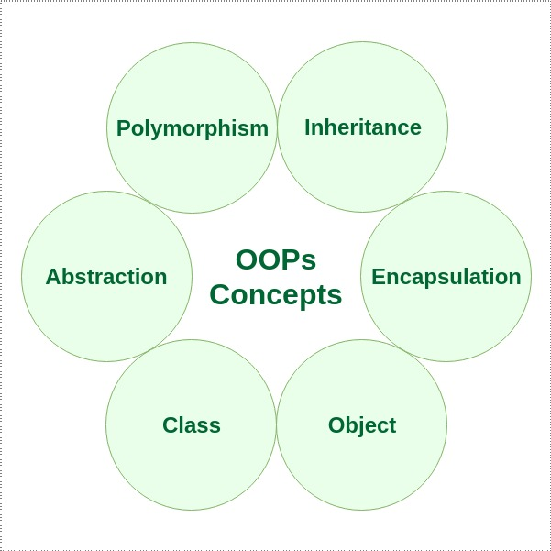

Slide 15
Inheritance is an important pillar of OOP(Object-Oriented Programming). It is the mechanism in java by which one class is allowed to inherit the features(fields and methods) of another class. In Java, inheritance means creating new classes based on existing ones. A class that inherits from another class can reuse the methods and fields of that class. In addition, you can add new fields and methods to your current class as well.
Code Reusability: The code written in the Superclass is common to all subclasses. Child classes can directly use the parent class code.
Acquiring the properties from parent
Parent Class/ Super Class/ Base Class
Child Class/ Sub Class/ Derived Class
Keyword - extends

Slide 16
Polymorphism
. More than one forms
1. Method Overloading (Compile Time Polymorphism) -
No. of argumets/ type of arguments will be different with same Method name
Class Name: same
Method Name: Same
arguments: different

Slide 17
2. Method Overriding: (Runtime Polymorphism)
- Inheritance should be applied
- Same method signature in both parent and child class
Class Name: different
Method Name: same
arguments: same
Constructor:
Initialize the object for a class
1. Default Constructor
2. Parametrized Constructor

Slide 18
Abstract Class:
- Class that can have both implemented and unimplemented (abstract) methods
- You cannot create object for the abstract class.
- To access the implemented methods of abstract class, you need to create a concrete class that extends abstract class.

Slide 19
Selenium 1.0 (RC)
(a).The Selenium Server
It starts and terminates the browser, translates and processes the Selenium commands sent from the test app. It behaves like an HTTP proxy, controls and verifies the HTTP messages exchanged between the client and the application under test.
(b). Client libraries
This module is the interface between the programming language and the Selenium Server. Selenium supports many programming languages, so their client libraries. The most common of them are Java, CSharp, Python, and Ruby.
Outdated now.
Selenium IDE (plugin- firefox)
Selenium IDE is a fully featured development environment (IDE) for composing the Selenium tests. It comes in the form of a Firefox Add-On. You can use it to record, edit, and for the debugging purpose. Initially, its creator used to call it as Selenium Recorder.
What can you do with Selenium IDE?
Run a customized JavaScript using the runScript command.
Export test cases in various supported formats.
Group test cases into test suites which you can convert into Selenium RC or Webdriver format.
Test a web application only with Firefox.

Slide 20
Selenium WebDriver:
What it can do?
- Can automate only web applications
- It can talk to browsers like chrome, firefox, edge, IE, Opera, Safari
- You can run your script in any platform (OS) - Windows, linux, mac, Android, ios
- You can write the script in any languages: java, javascript, python, Ruby, Pearl, C#
Selenium
Test Web application
Run across different platfom ie ,modzilla , chrome
What it cannot do?
- Can it automate excel sheet? - No!! - (Java libraries - Apache POI)
- Can it automate mainframe application? - No!! - (Java libraries - WinAppDriver)
- Can it talk to database? - No!! - (Java Libraries - JDBC)
- Can it automate mobile based apps? - No!! - (Java Libraries - Appium)
- Can we do performance testing? - No!! JMeter, Gatling, Load Runner, Locust

Slide 21
Selenium Grid
Selenium Grid is a dynamic tool that can distribute and run the Selenium tests across many physical/virtual machines in a concurrent order. It can significantly expedite the testing process across different browsers and reduce the testing cycle by giving quick and accurate results.
Selenium Grid can simultaneously invoke the multiple instances of WebDriver (or Selenium RC) tests using the same test code. You just have to make the test code is available on every node running the tests.
Selenium Grid architecture consists of a Hub and a Node.
Selenium Maven is the latest build testing tool. It has several new features as compare to Ant, like dependency, etc. Maven is a project build or project management tool. It is used to check the compilation issues between framework components whenever multiple test engineer integrates their files into the same framework.

Slide 22
Maven Dependency
pom.xml – (Project Object Model)
It is an XML file that contains information about the project and configuration details used by Maven to build the project and resides in the base directory of current project.
configuration details can be –
project dependencies
plugins
goals
build profiles
project version
developers
mailing list
Project dependencies – contains all the dependency.
Navigate to http://mvnrepository.com/ to search for dependencies (for selenium, testNG etc) and include them into the pom.xml

Slide 23
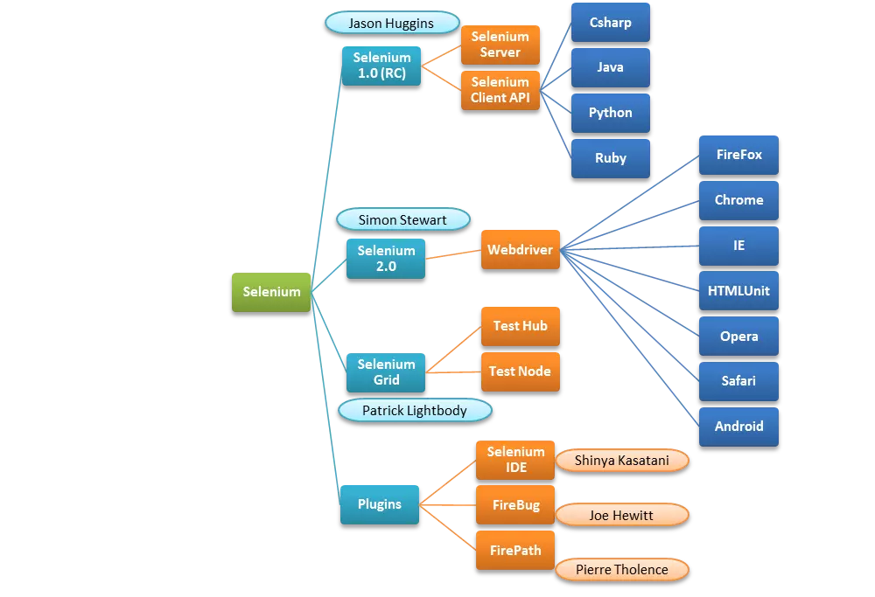

Slide 24
Locators (8):
1. id --> tag attribute -> 1st priority - may have changing numbers
2. name --> attribute --> 2nd priority - cannot use when it is duplicated
3. linktext --> tag name should be <a> (anchor) --> 3rd priority
4. classname --> attribute --> 4th priority (do not use classname when it has spaces in between)
5. tagName
6. partialLinkText --> tag name should be <a> (anchor)
7. xPath
8. css --> only top to bottom

Slide 25
xPath - XML Path
1. Absolute xPath - It should start with root tag
- It should start with '/'
- Fastest
/html/body/div[2]/div[2]/div/form/p/input
Mandatory - /tagName
Java - Index starts with 0
xPath - Index starts with 1
2. Relative xPath
- Slower
Mandatory - // tagName
Optional

Slide 26
Basic xPath:
1. Attribute based xPath:
//tagName[@attributeName='attributeValue']
//input[@id='password']
//tagName[@attributeName='attributeValue'][@attributeName='attributeValue'] - AND condition
//tagName[@attributeName='attributeValue' and @attributeName='attributeValue']
//tagName[@attributeName='attributeValue' or @attributeName='attributeValue']
//input[@id='password'][@name='PASSWORD']
//input[@id='password' and @name='PASSWORD']
//input[@id='password' or @name='password']
//input[@value='Login']

